Slide 1
Taste in Popular Music in the United States and around the Globe
An Exploratory Data Analysis using the Spotify Web API, by Jake Mullins

Slide 2
Goal:
Questions:
Hypothesis:
Explore Spotify's datasets to gain an understanding of the features that their app uses to classify audio tracks and tailor its music recommendations for its users.
Use this data to compare popular music in select regions
How similar is popular music in the United States, United Kingdom, Mexico, and Canada?
Which country’s musical taste is most similar to the global population’s musical taste?
The USA is the country whose popular music is most similar to the Global

Slide 3
Method
Analyze the current "Top 50" playlists for each region.
Similarity in Popular Tracks
Similarity in Popular Genres
Similarity in the ‘Features’ of tracks
Create functions for calculating these metrics that are easily scalable to include much larger sample sizes.

Slide 4
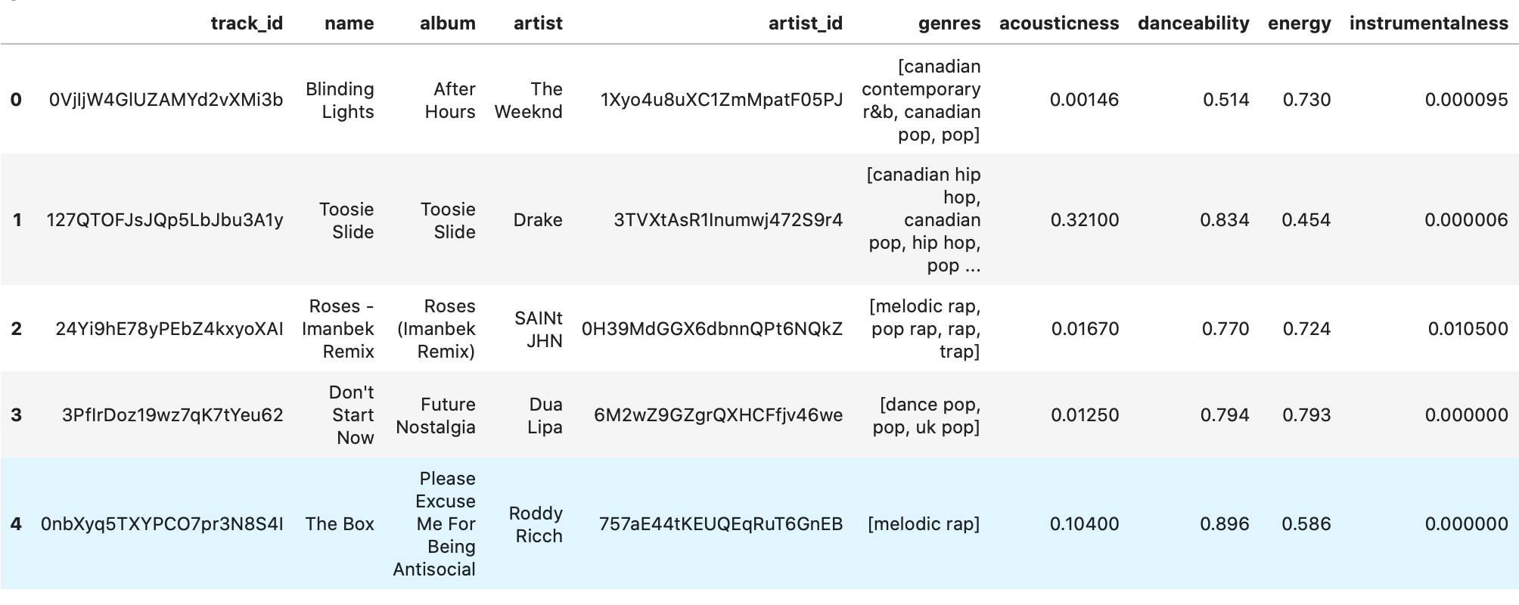
Example Data:

Slide 5
Track Set Similarity
How many tracks does each playlist have in common?

Slide 6
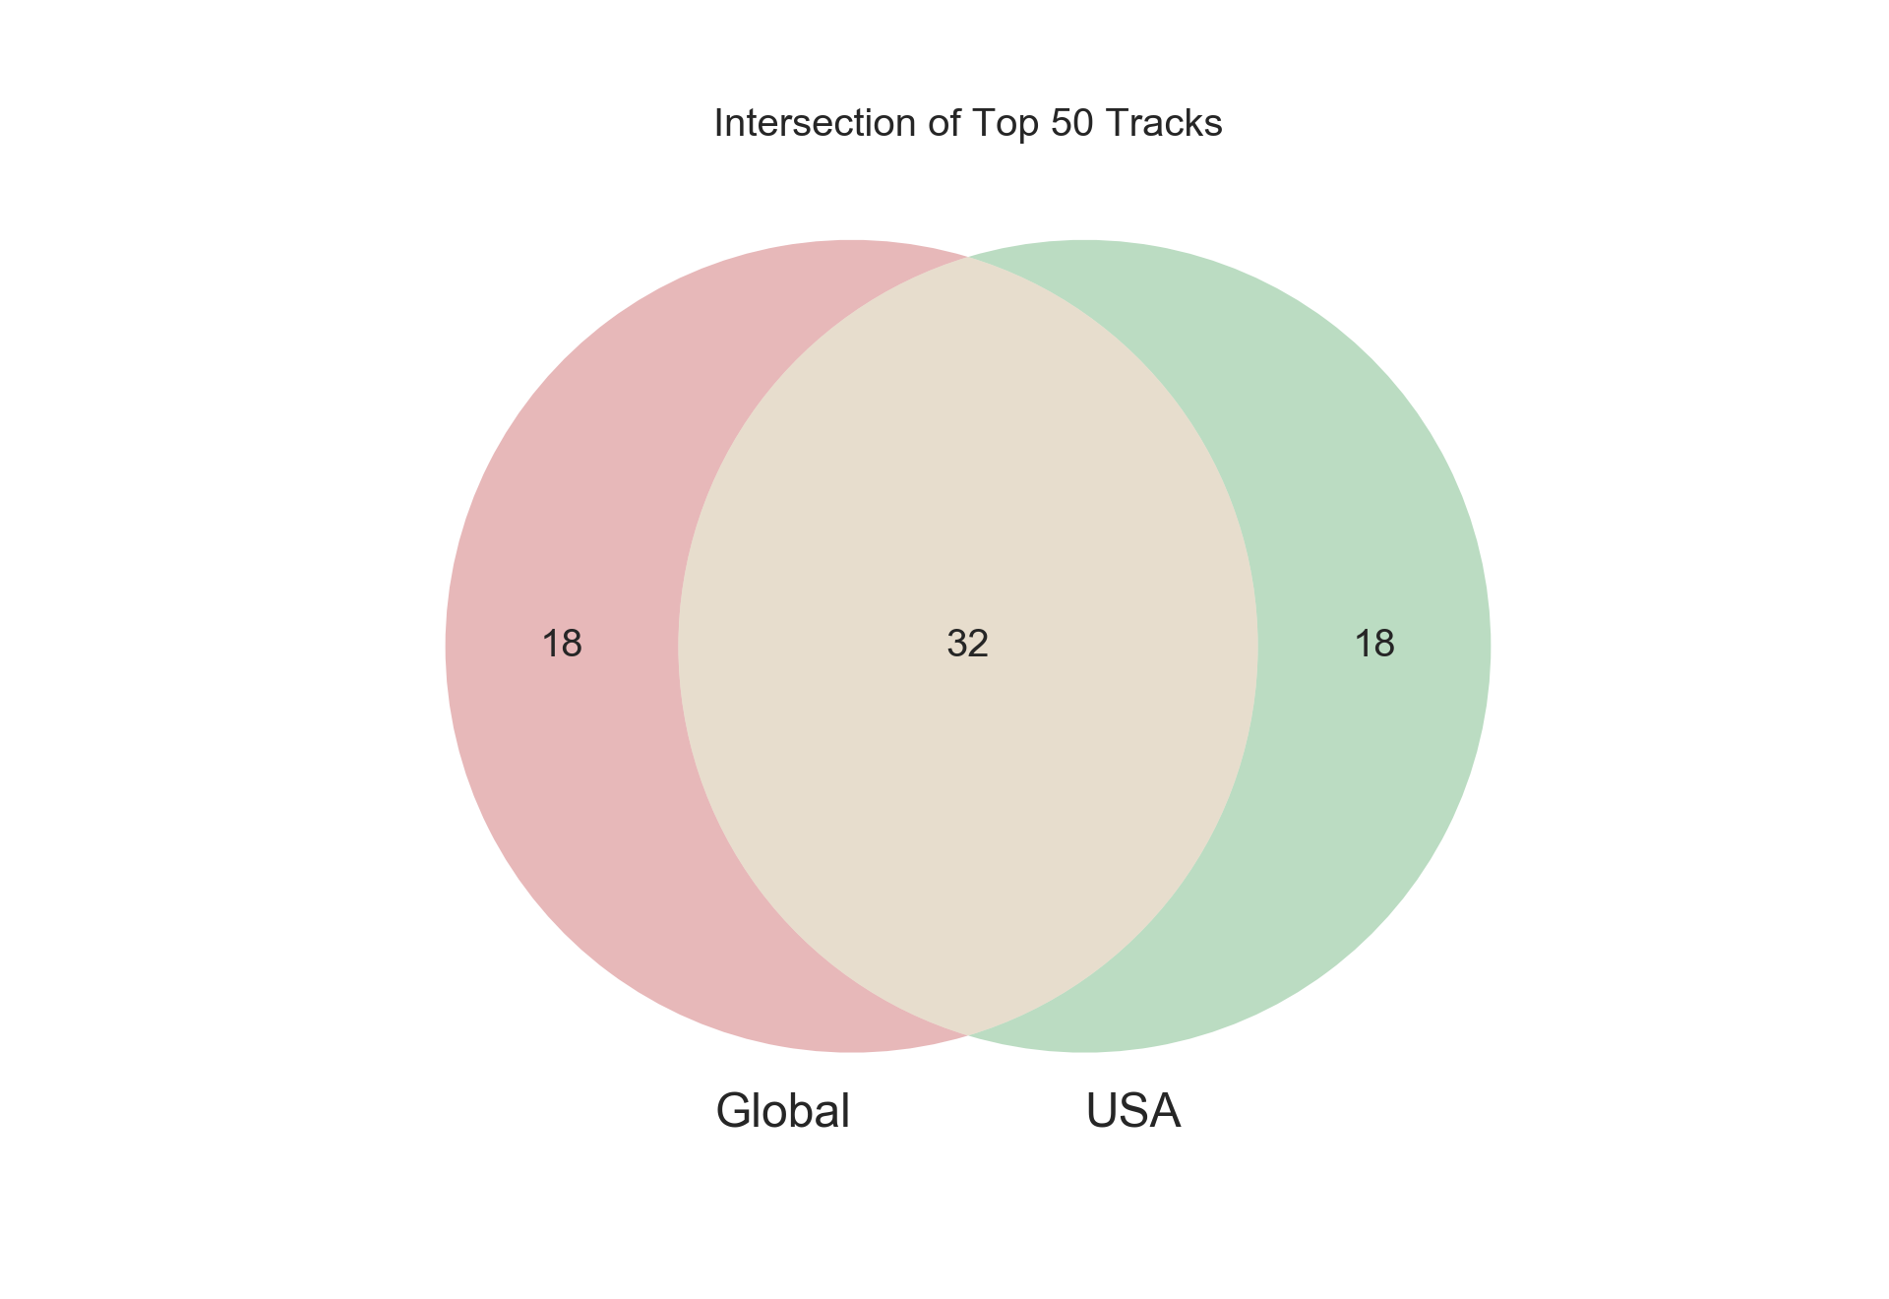

Slide 7
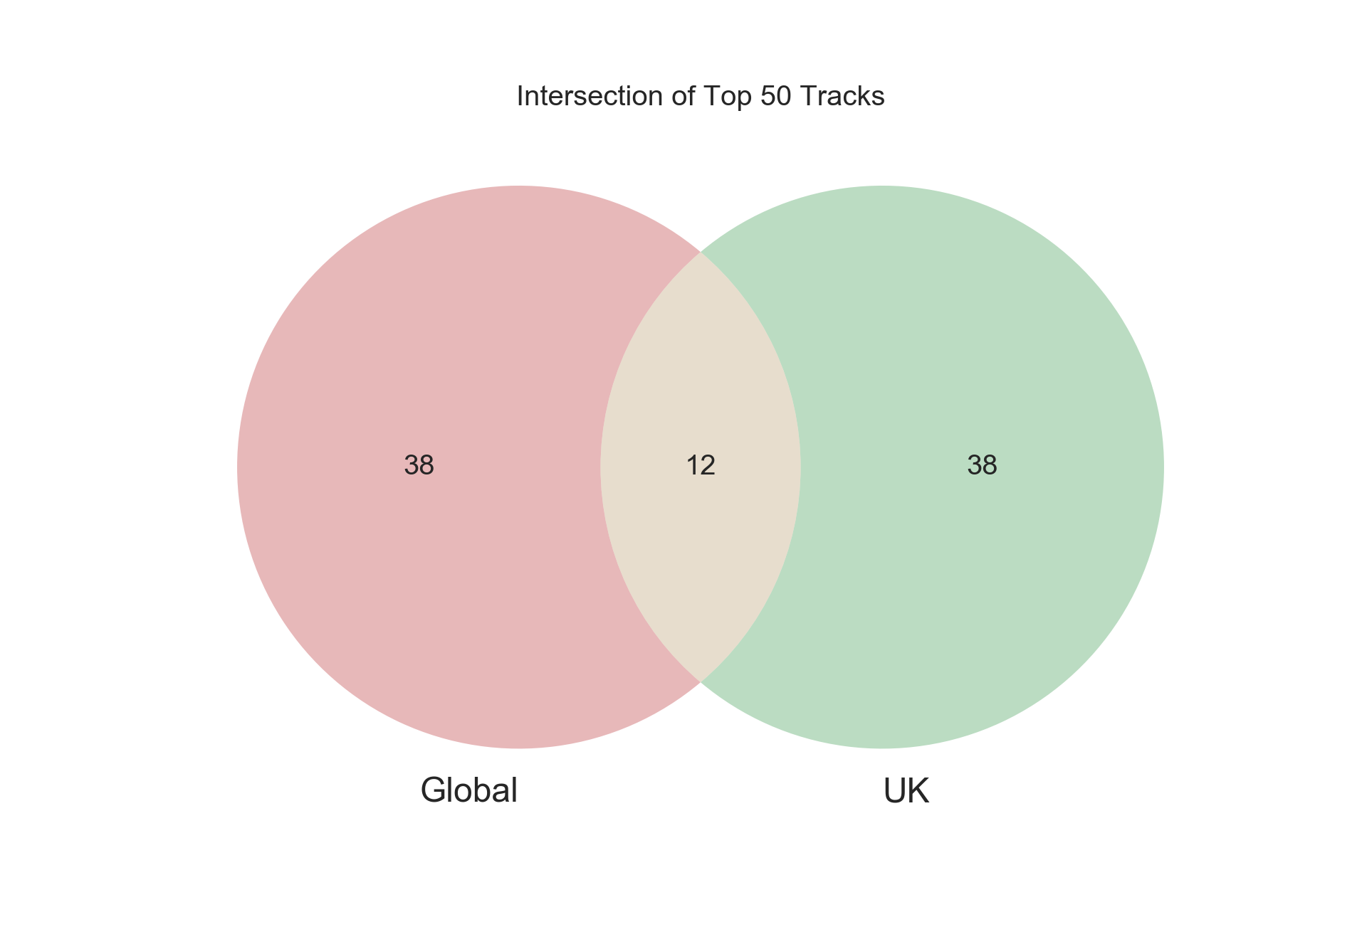
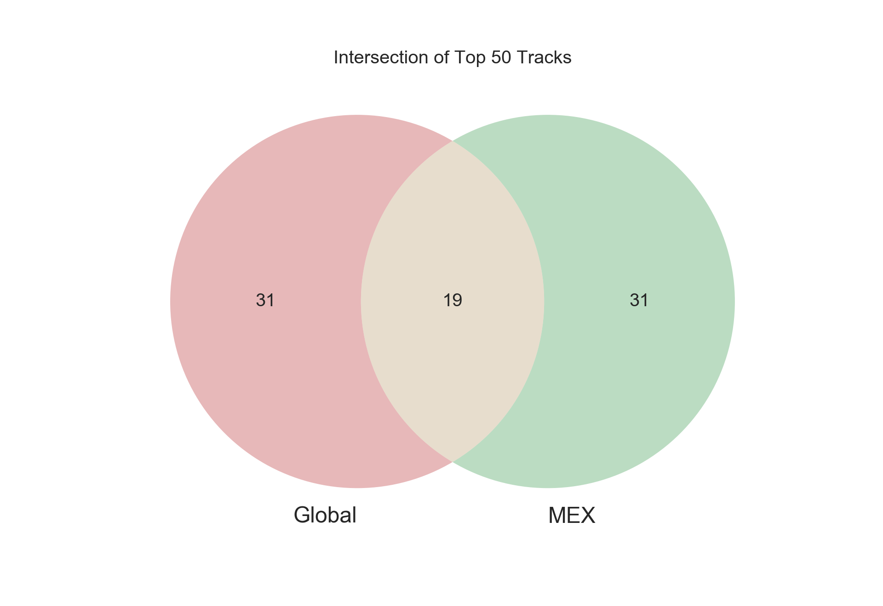
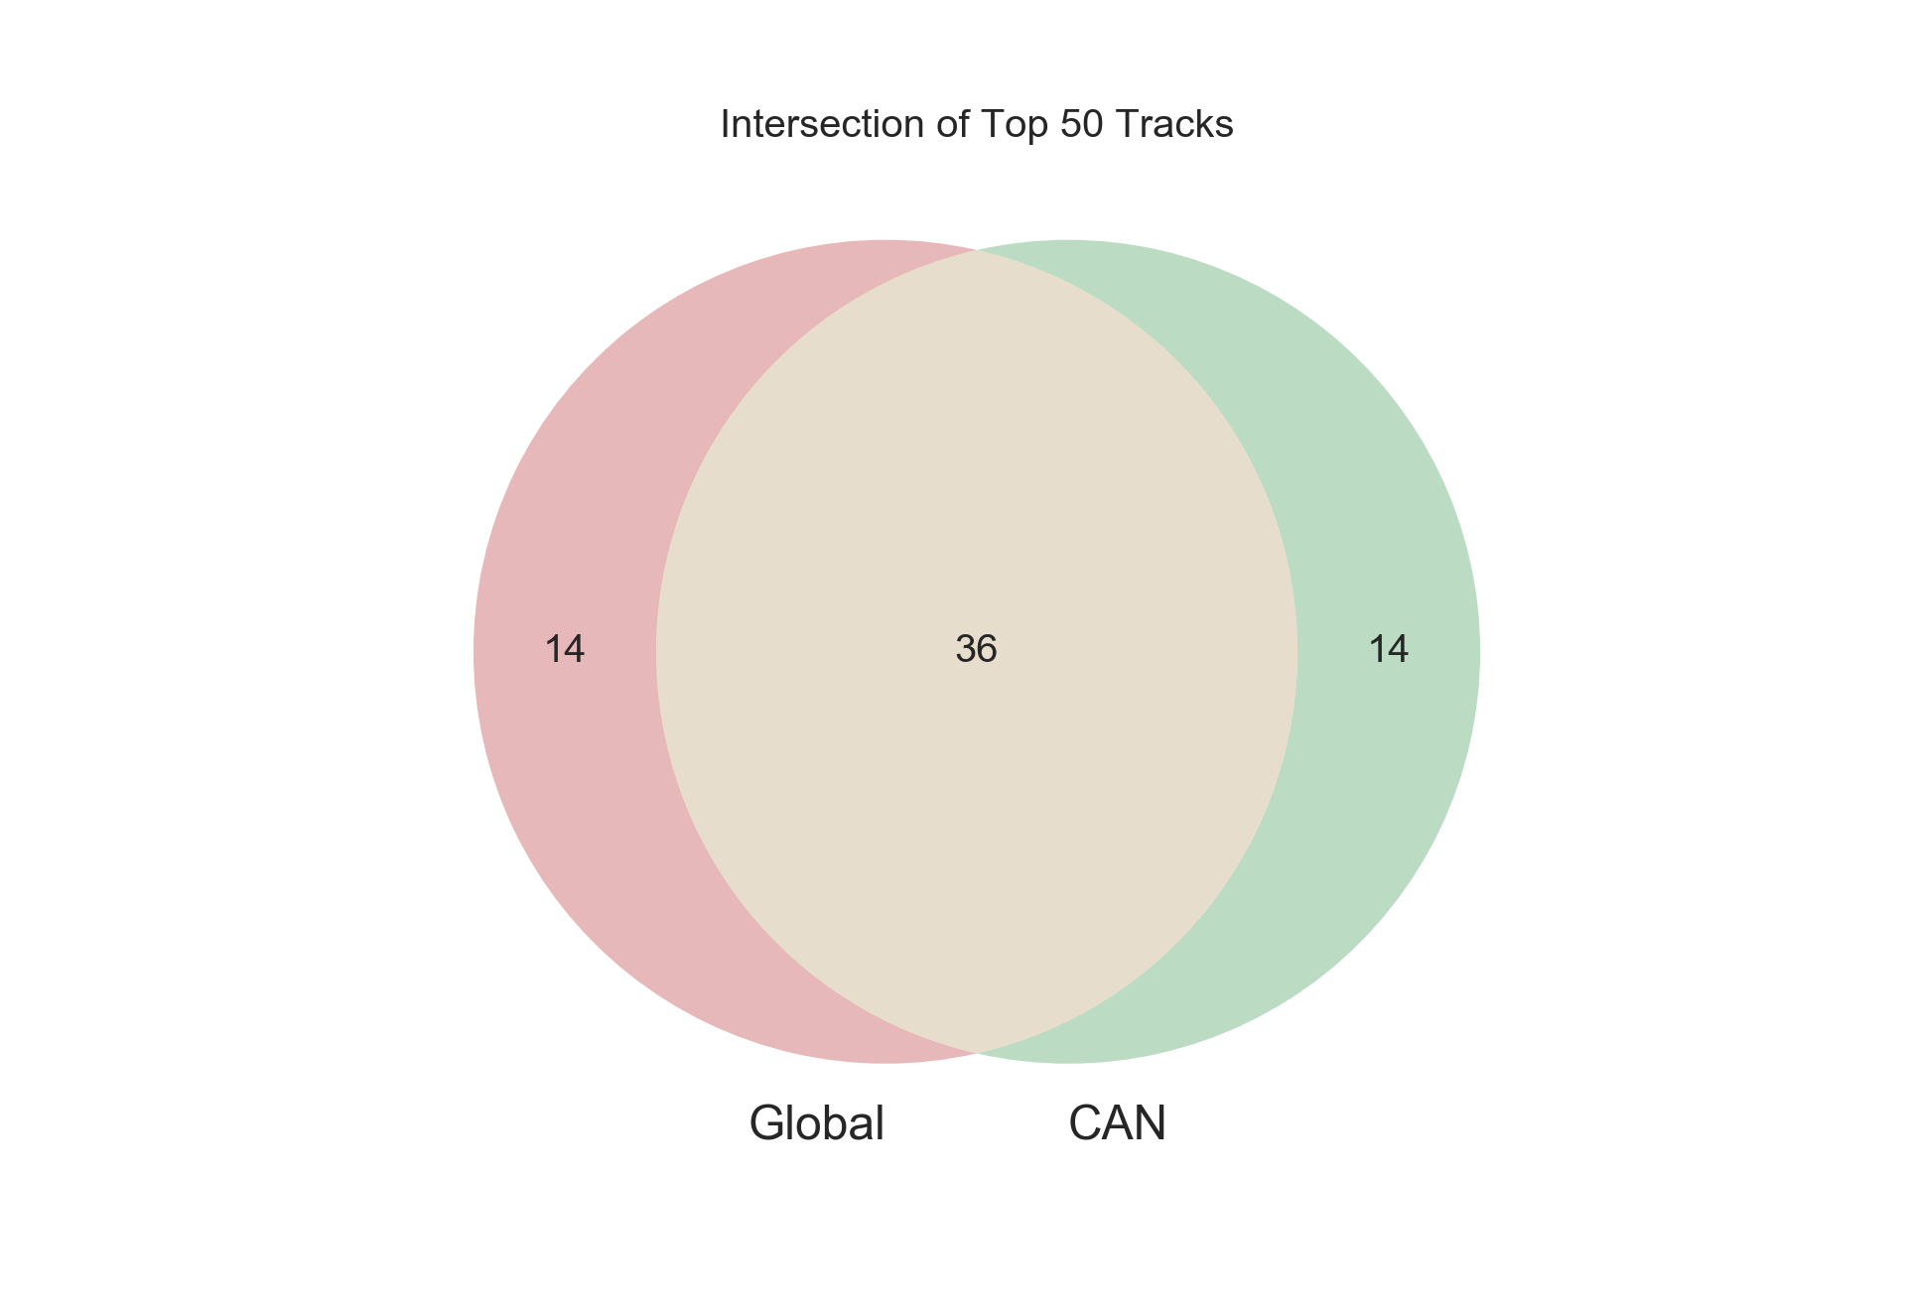

Slide 8
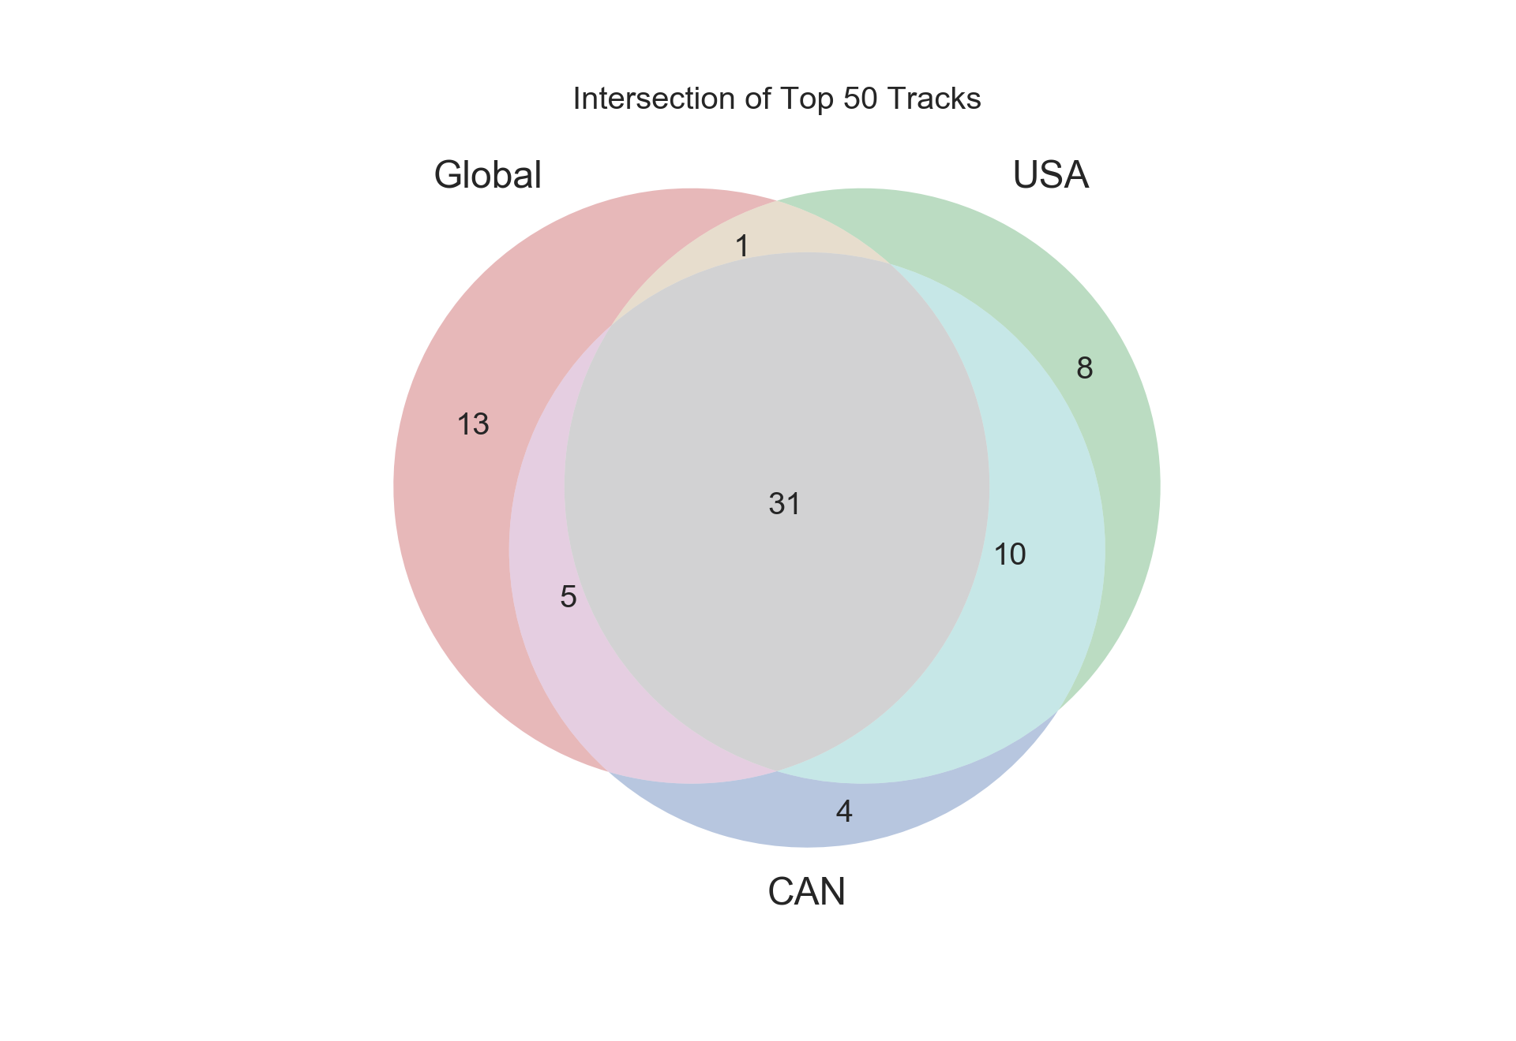
Result: Canada has the highest number of tracks in common with the Global set.

Slide 9
Genre Similarity
Count the frequency of each genre in a playlist, then calculate the cosine similarity for every combination of playlists.

Slide 10
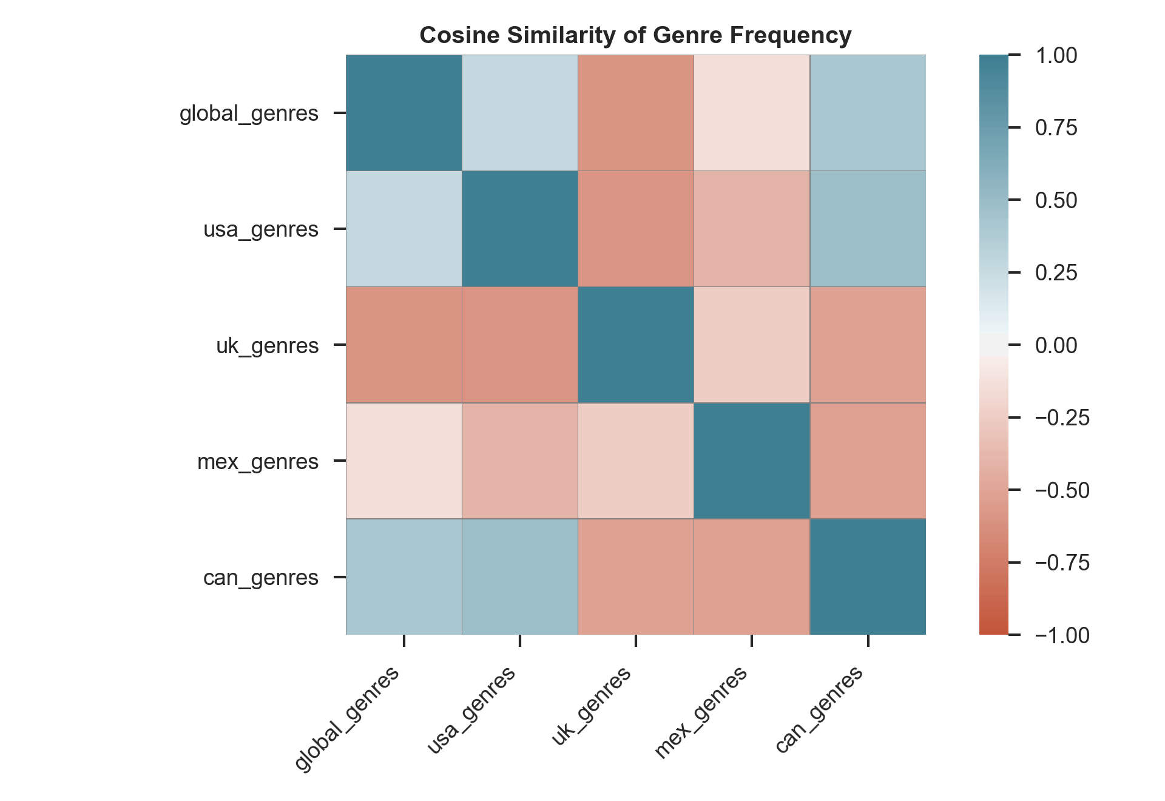
Result: Canada’s genres are most similar to the Global genres.

Slide 11
Feature Similarity
Acousticness
1.0 represents high confidence that the track is acoustic
Danceability
1.0 is most danceable
Energy
1.0 = death metal
Instrumentalness
1.0 represents high confidence that there are no vocals
Liveness
1.0 represents high confidence that a live audience is audible in the track
Loudness :
Decibels (normalized)
Speechiness
Rap is typically .33-.66
Tempo
BPM (normalized)
Notes:
y

Slide 12
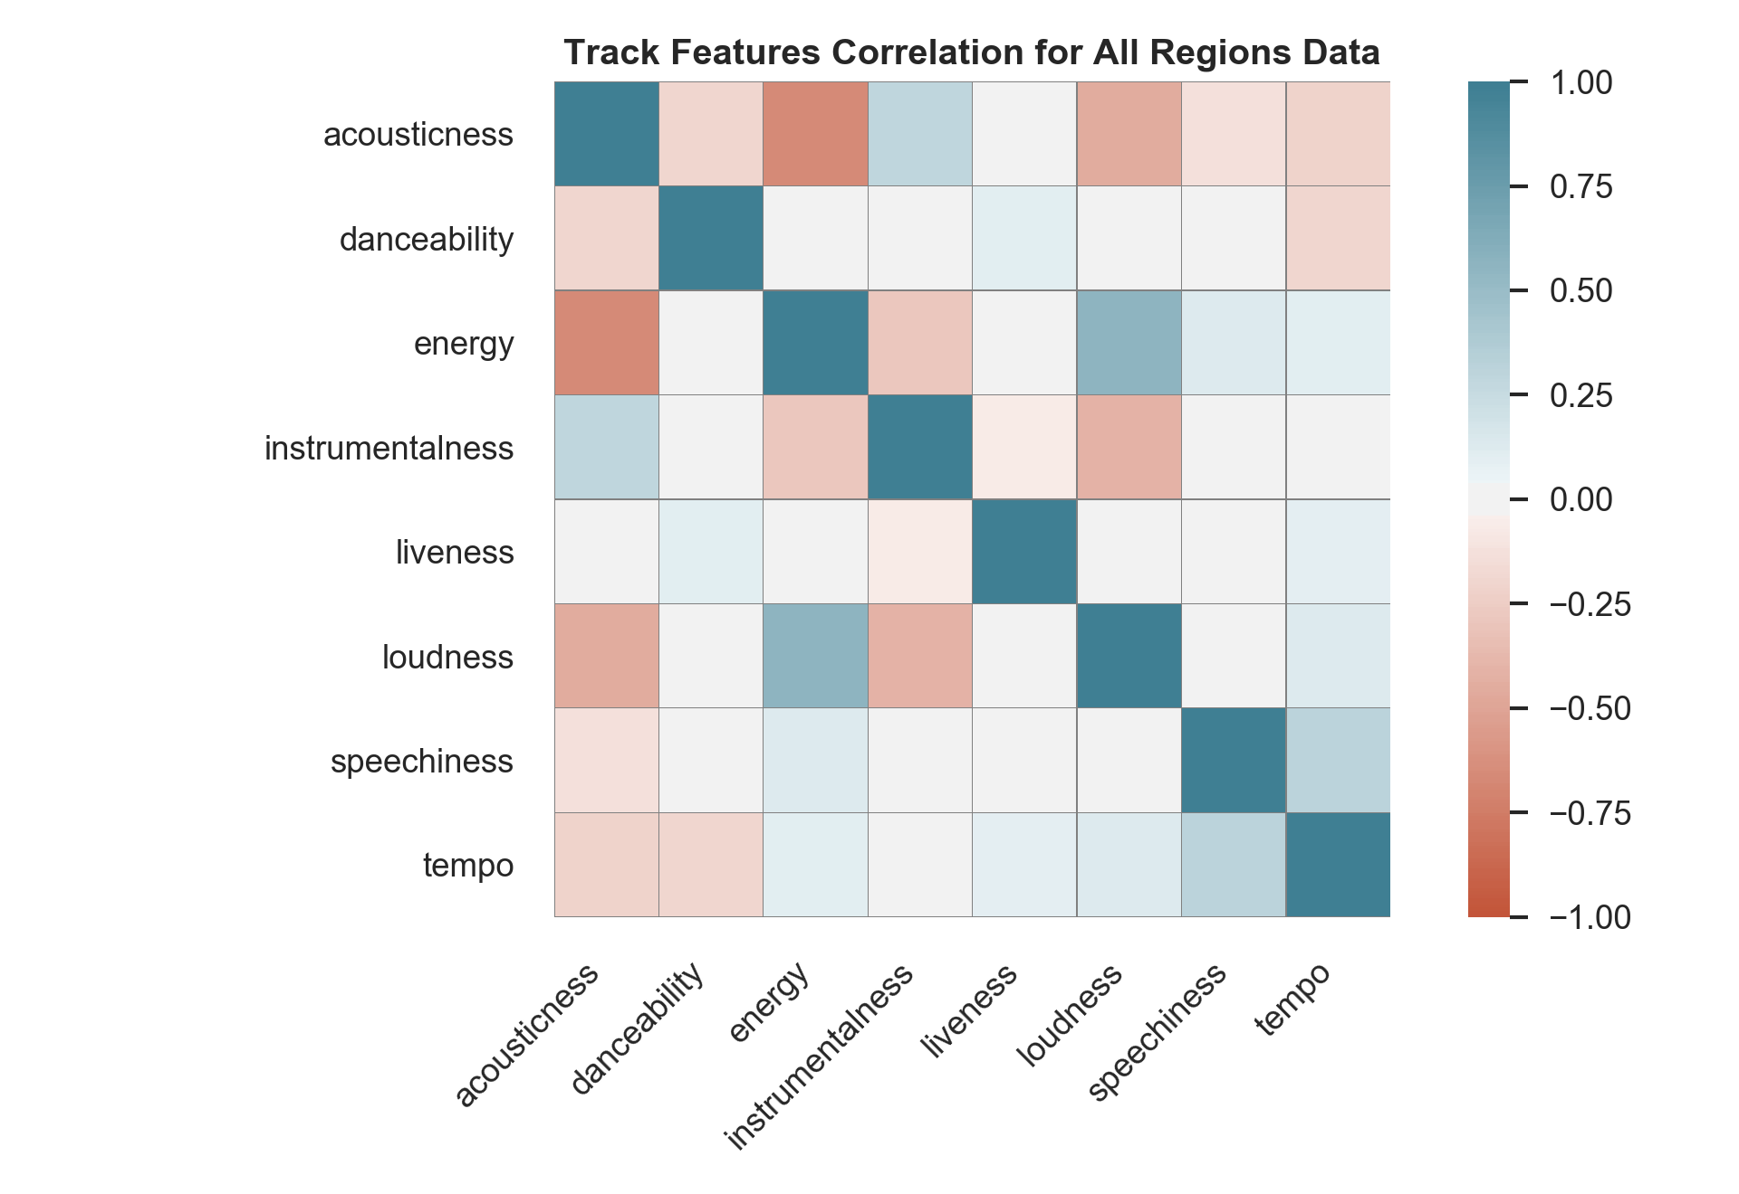

Slide 13
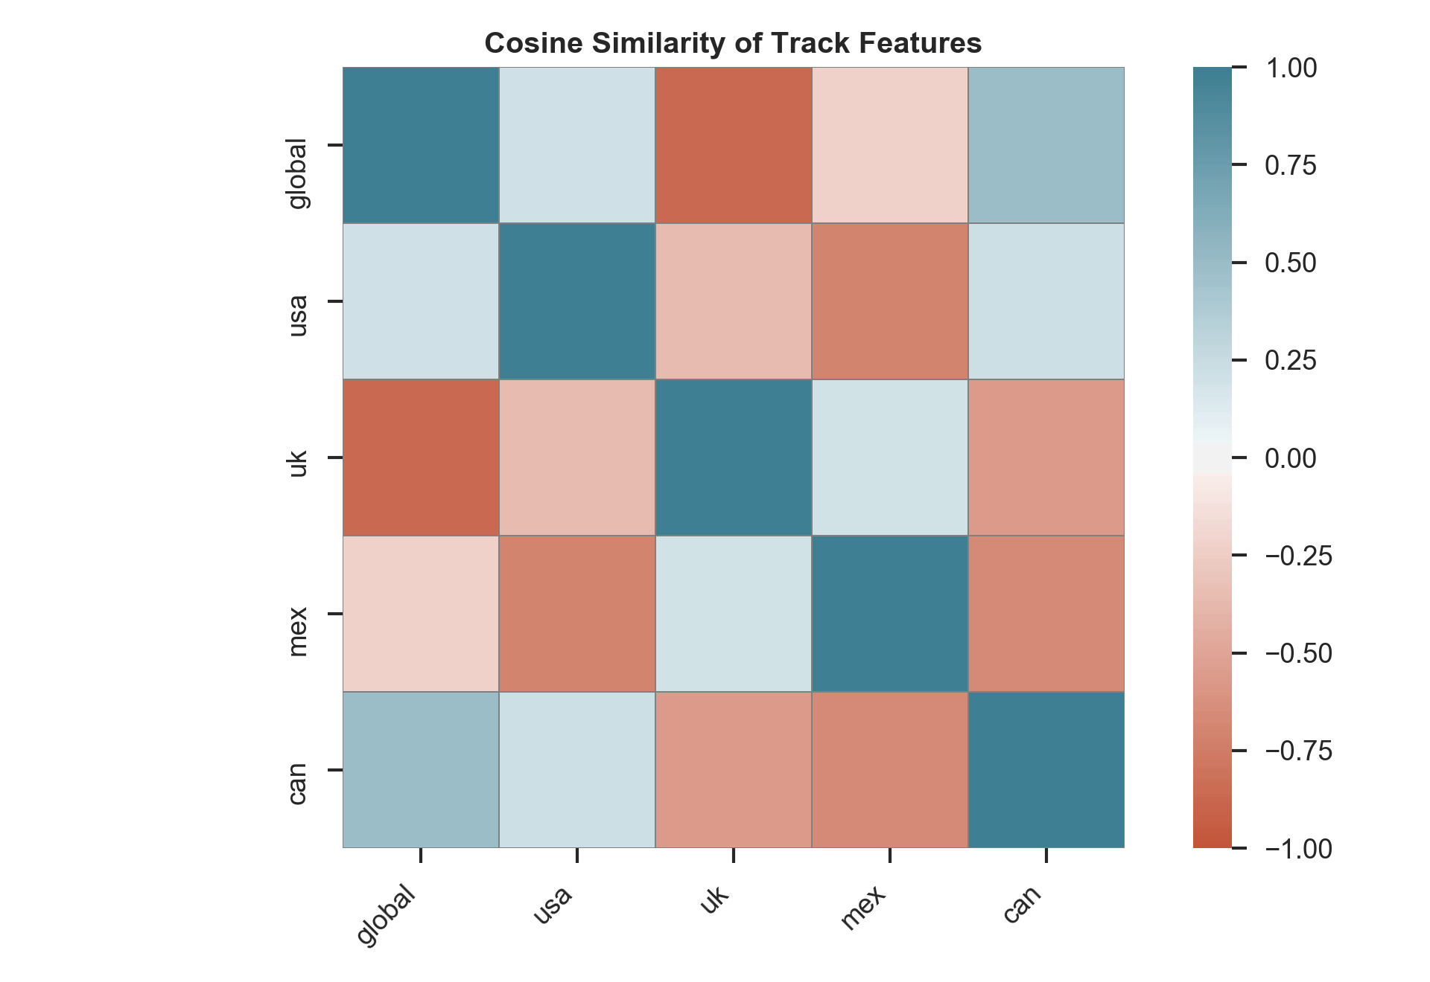
Result: Canada’s track features are the most similar to the Global track features.

Slide 14
Feature Distributions

Slide 15
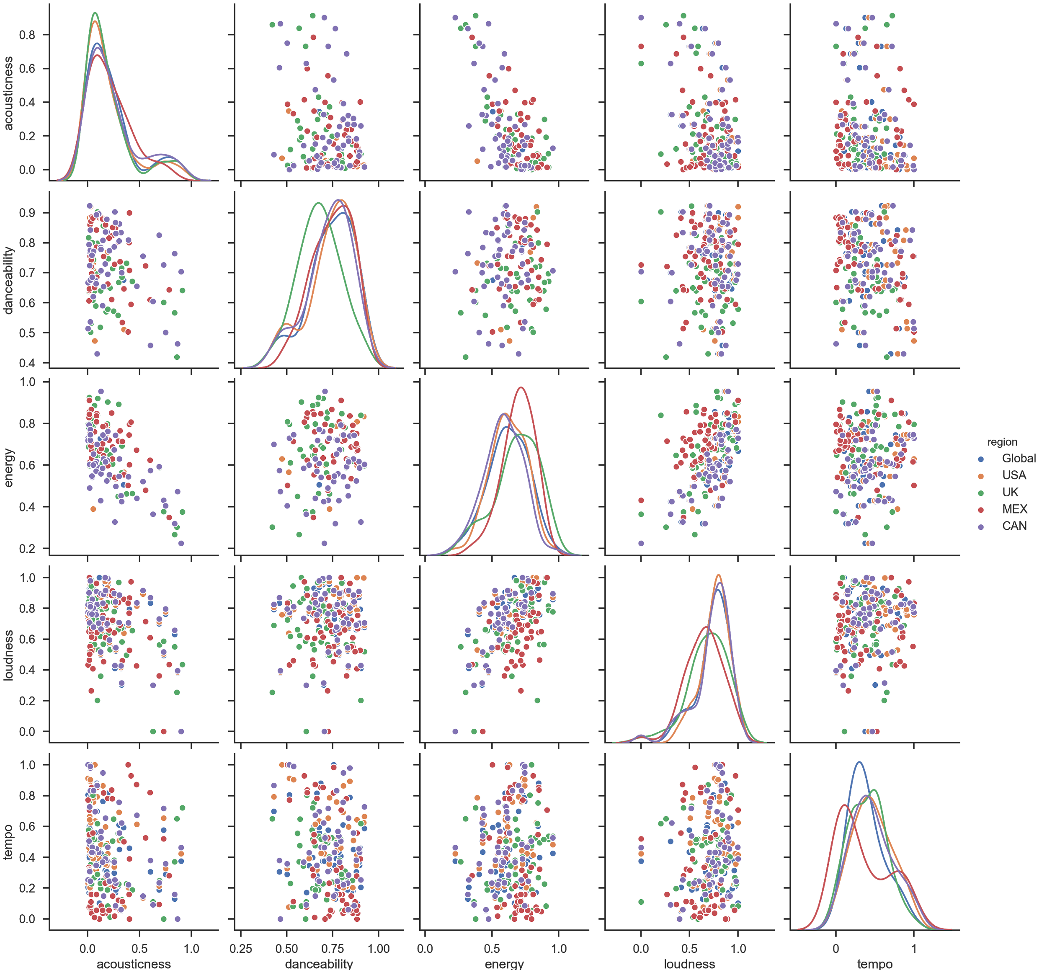

Slide 16
Hypothesis Test
Null Hypothesis: There is no difference in the mean “energy” of the Global tracks and the USA tracks.
Use a two sided, independent t-test with alpha = .05 as our rejection threshold.

Slide 17
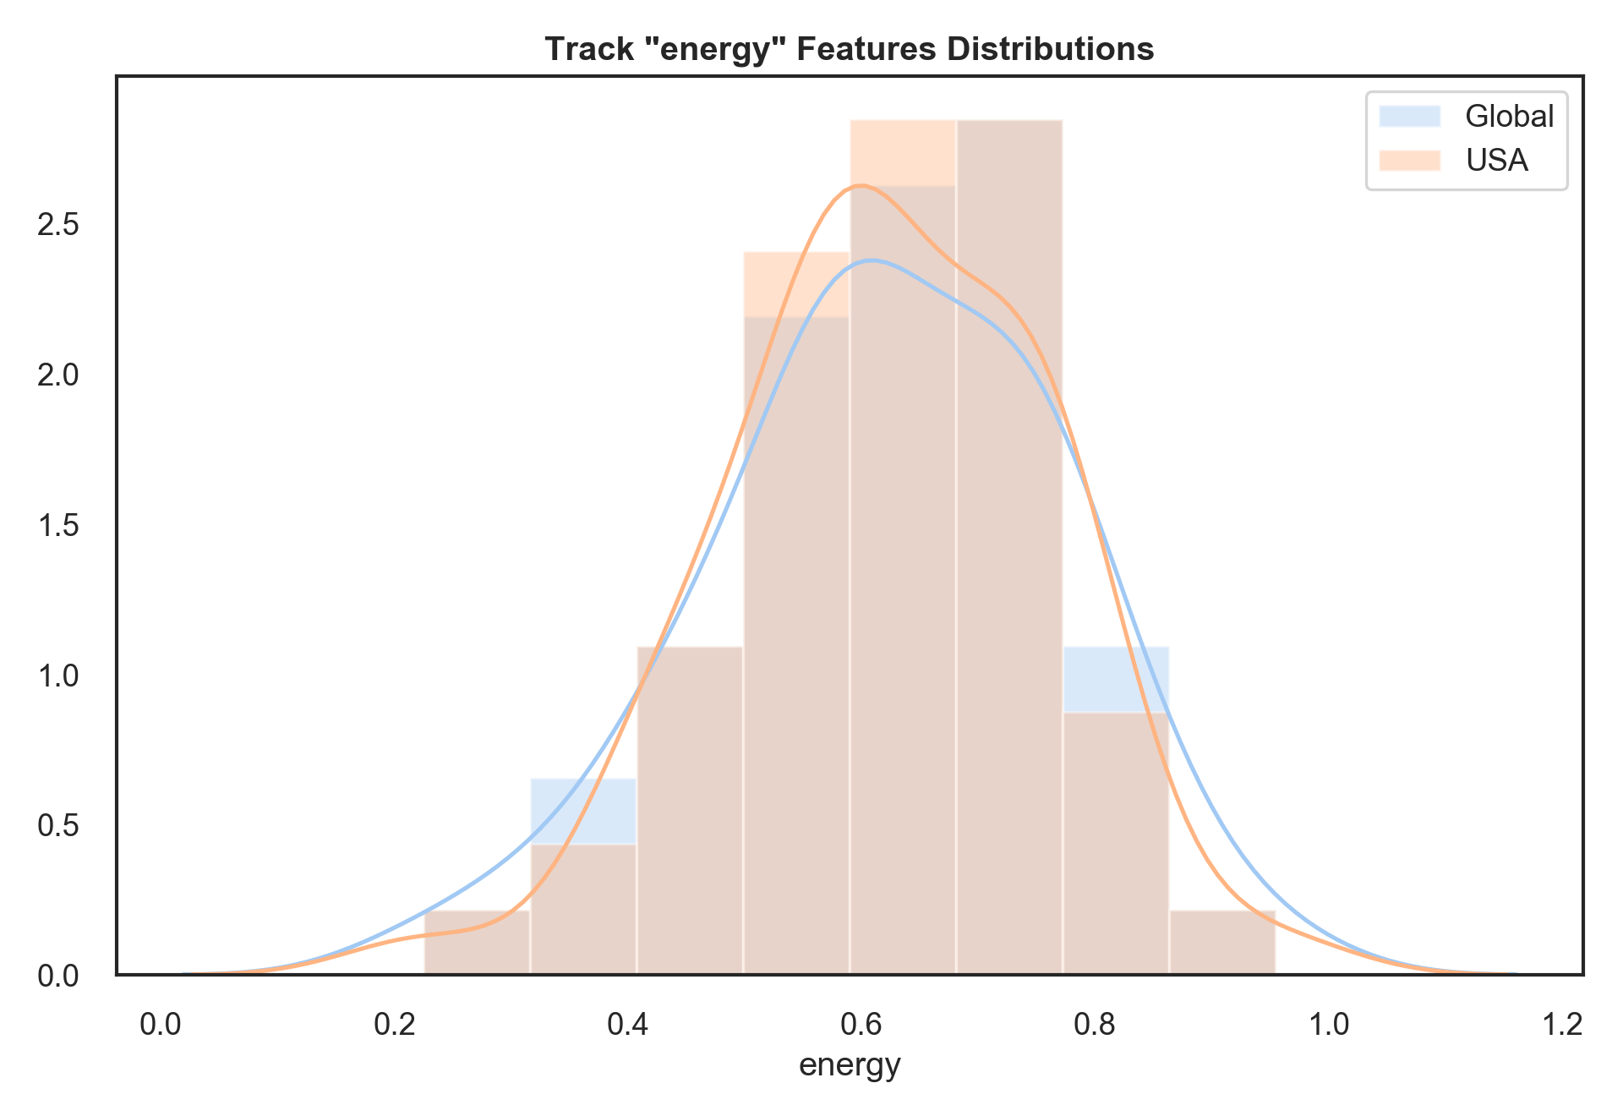
pval = 0.9966979993191145

Slide 18
Conclusions
In this instance, we fail to reject the null hypothesis. We cannot say that the mean energy of the US tracks is different from the mean energy of the Global tracks.
The data used in this project tells us a lot about a brief snapshot in time. Repeating these tests across a range of times would yield very interesting results about changes in musical taste over time.

Slide 19
Thank You.
GitHub
github.com/jakemull13
LinkedIn
linkedin.com/jacob.c.mullins
Email
jakemull13@gmail.com

